Slide 1
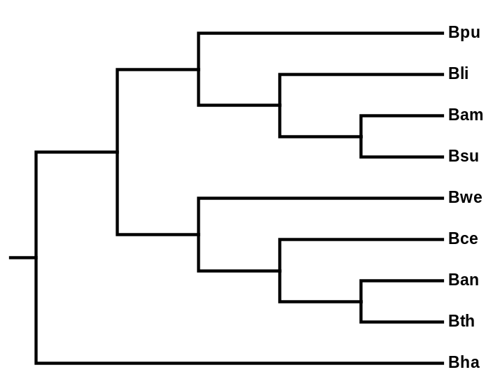
(A)
(B)
H2:
ω_{O}≠ ω_{S} ≠ ω_{C}
67
16
3
ω_{S}
ω_{S}
ω_{S}
d.f.=1
ω_{S}
H1c:
ω_{O}= ω_{S} ≠ ω_{C}
H1s:
ω_{O}= ω_{C} ≠ ω_{S}
ω_{S}
ω_{S}
80
ω_{O}
ω_{S}
75
6 32 19
ω_{C}
273
ω_{C}
ω_{C}
5 3
ω_{C}
ω_{C}
ω_{C}
H0:
ω_{O}= ω_{S} = ω_{C}
d.f.=1
ω_{C}
973
182
19
Figure 5
Notes:
FDR = 0.05
See whole.genome.codeml.042109/R.Bha4sub4cereus/LRT.H2C1S1.050409.R

Slide 2
(A)
(B)
H2: ω_{O}≠ ω_{S} ≠ ω_{C}
107 conserved genes
3 coat genes
17 essential genes
ω_{S}
ω_{S}
ω_{S}
ω_{S}
ω_{S}
d.f.=1
d.f.=1
ω_{S}
ω_{O}
ω_{S}
ω_{C}
H1c: ω_{O}= ω_{S} ≠ ω_{C}
452 conserved genes
6 coat genes
41 essential genes
H1s: ω_{O}= ω_{C} ≠ ω_{S}
464 conserved genes
9 coat genes
54 essential genes
ω_{C}
ω_{C}
ω_{C}
ω_{C}
ω_{C}
d.f.=1
ω_{C}
d.f.=1
H0: ω_{O}= ω_{S} = ω_{C}
1327 conserved genes
20 coat genes
196 essential genes
Figure 4
Notes:
FDR = 0.05

Slide 3
ω_{S}
H2: ω_{O}≠ ω_{S} ≠ ω_{C}
107 conserved genes
3 coat genes
17 essential genes
ω_{S}
ω_{S}
ω_{S}
ω_{S}
ω_{S}
ω_{O}
ω_{S}
ω_{C}
d.f.=1
d.f.=1
ω_{C}
ω_{C}
H1c: ω_{O}= ω_{S} ≠ ω_{C}
452 conserved genes
6 coat genes
41 essential genes
H1s: ω_{O}= ω_{C} ≠ ω_{S}
464 conserved genes
9 coat genes
54 essential genes
ω_{C}
ω_{C}
ω_{C}
ω_{C}
d.f.=1
d.f.=1
H0: ω_{O}= ω_{S} = ω_{C}
H0: ω_{O}= ω_{S} = ω_{C}
1327 conserved genes
20 coat genes
196 essential genes
H1c: ω_{O}= ω_{S} ≠ ω_{C}
H1s: ω_{O}= ω_{C} ≠ ω_{S}
H2: ω_{O}≠ ω_{S} ≠ ω_{C}

Slide 4
ω_{S}
ω_{S}
ω_{S}
ω_{S}
H0: ω_{O}= ω_{S} = ω_{C}
ω_{S}
ω_{O}
ω_{S}
ω_{S}
H1c: ω_{O}= ω_{S} ≠ ω_{C}
ω_{C}
ω_{C}
ω_{C}
ω_{C}
H1s: ω_{O}= ω_{C} ≠ ω_{S}
ω_{C}
ω_{C}
ω_{C}
H2: ω_{O}≠ ω_{S} ≠ ω_{C}

Slide 5
H2: ω_{O}≠ ω_{S} ≠ ω_{C}
107 conserved genes
3 coat genes
17 essential genes
d.f.=1
d.f.=1
H1c: ω_{O}= ω_{S} ≠ ω_{C}
452 conserved genes
6 coat genes
41 essential genes
H1s: ω_{O}= ω_{C} ≠ ω_{S}
464 conserved genes
9 coat genes
54 essential genes
d.f.=1
d.f.=1
H0: ω_{O}= ω_{S} = ω_{C}
1327 conserved genes
20 coat genes
196 essential genes
Number of genes that accepted the alternative hypothesis using likelihood ratio tests (FDR=0.05)
Notes:
Bonferroni correction gave similar results.

Slide 6
Significant difference of between subtilis and cereus clades: Likelihood ratio tests (FDR=0.05)
H2: ω_{O}≠ ω_{S} ≠ ω_{C}
107 conserved genes
3 coat genes
17 essential genes
d.f.=1
d.f.=1
H1c: ω_{O}= ω_{S} ≠ ω_{C}
452 conserved genes
6 coat genes
41 essential genes
H1s: ω_{O}= ω_{C} ≠ ω_{S}
464 conserved genes
9 coat genes
54 essential genes
d.f.=1
d.f.=1
H0: ω_{O}= ω_{S} = ω_{C}
1327 conserved genes
20 coat genes
196 essential genes
Notes:
Bonferroni correction gave similar results.

